Slide 1
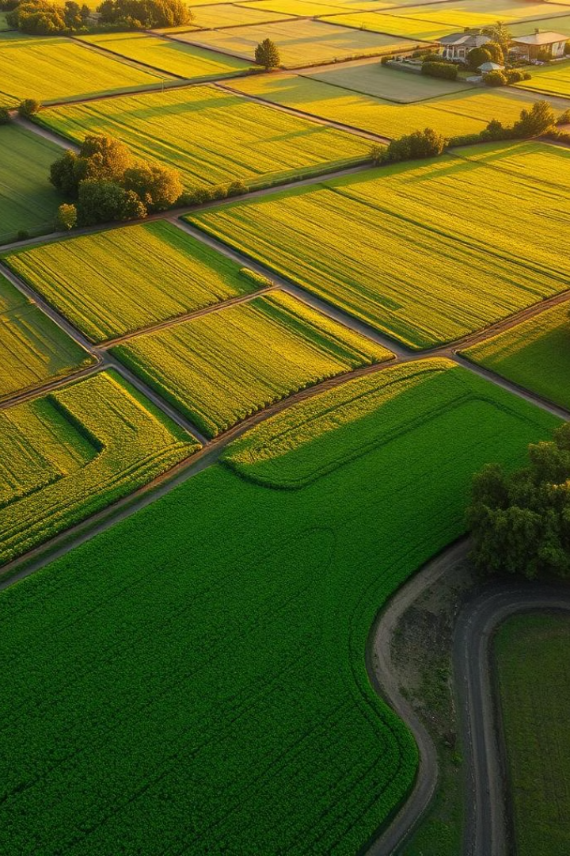

Resilient Crop Recommendation AI
Our Resilient Crop AI solution tackles the critical challenge of balancing farm sustainability with market profitability. Our team, comprised of experts in agriculture and machine learning, has developed a novel system to provide farmers with data-driven crop recommendations.
We combine farm-first clustering with distribution-aware market matching to ensure both sustainable and profitable crop choices. Our innovative AI aims to revolutionize crop selection, promoting environmental stewardship and economic success for farmers.
by SADANAND RAJPUROHIT

Slide 2
Addressing the Crop Decision Dilemma
Farmers face a complex decision-making process when selecting crops, often relying on localized knowledge or prioritizing yield alone. This can neglect the long-term sustainability of their land and the fluctuating demands of the market.
The Problem
Our Goal
Lack of holistic AI solutions
To bridge this gap, we provide an AI-driven solution that balances sustainability with real-time market profitability. Our system reasons across both, incorporating explainability, to support informed crop decisions.
Siloed datasets (farm vs. market)
Neglect of explainability

Slide 3





A Multi-Agent AI Solution
Our proposed system integrates a multi-agent AI approach to provide farmers with comprehensive crop recommendations. It is designed to consider both sustainability and market factors, ensuring profitable and environmentally sound decisions.
Sustainability Zones
Cluster farm data crop-wise
Fuzzy Logic Matching
Match conditions to zones
Profitability Index
Score market data
Combined Ranking
Sustainability fit + market score
GPT-4 Advisory
Explain results and log data

Slide 4

Technologies & Deployment
Our system utilizes a range of cutting-edge technologies to ensure accuracy, reliability, and ease of deployment. We leverage Python, Scikit-learn, PyTorch, and OpenAI's GPT-4 API to provide a robust and user-friendly solution.
Clustering
Fuzzy Logic
Spectral Clustering + PCA
Soft crop suitability matching
GPT-4
Natural language advisory
Fully tested in Jupyter, our system is deployment-ready for integration into Agri SaaS platforms or extension portals. The Streamlit-ready interface offers interactive access for farmers.

Slide 5

Conclusion: Bridging the Farm-Market Gap
Our solution offers intelligent, explainable, sustainable, and profitable crop decisions. This bridge is created by probabilistic reasoning that can work across datasets.
Fuzzy Fallback
Farm-First Clustering
Recommendations
Cross-data match
LLM Explanation
Farmer transparency
We believe this model is ready for scale and opens new research pathways in AI-driven agriculture.

Slide 6
Supporting Materials & References
To provide a comprehensive understanding of our solution, we have included a range of supporting materials. These resources offer detailed insights into the methodologies, technologies, and datasets used in our project.
Code & Documentation
Data & Explanation
Visuals
Jupyter Notebook: Sustainable_Agri_AI.ipynb
Datasets: farmer_advisor_dataset.csv, market_researcher_dataset.csv
2D + 3D cluster maps with PCA
Softmax logic for distributional reasoning
Technical Doc: Resilient_Crop_AI_Theory_and_Innovation.docx
GPT-4 integrated for explanation layer

